Slide 1

Shri Ram Murti Smarak College of Engineering, Technology and Research
Topic- Cryptocurrency Trading Website
Presented To:-
Ms. Monica Mitra
Guided by:-
Prof.(Dr.) LS Maurya
Presented By:-
Vansh K Tamta
(2104500100063)
Prince Rathore
(2104500100044)

Slide 2

Content
Introduction
Motivation
Problem Statement
Objectives
Literature Review
Tools and Technology
Methodology
Applications
Conclusion
References

Slide 3
Introduction
In recent years, the tendency of the number of financial institutions to include cryptocurrencies in their portfolios has accelerated. Cryptocurrencies are the first pure digital assets to be included by asset managers.
It is therefore important to summarise existing research papers and results on cryptocurrency trading, including available trading platforms, trading signals, trading strategy research and risk management.
Cryptocurrencies have experienced broad market acceptance and fast development despite their recent conception. Many hedge funds and asset managers have begun to include cryptocurrency-related assets into their portfolios and trading strategies
The academic community has similarly spent considerable efforts in researching cryptocurrency trading. This paper seeks to provide a comprehensive survey of the research on cryptocurrency trading.

Slide 4
Motivation
Many traders are motivated by the potential for significant profits. Cryptocurrencies have experienced rapid price appreciation in the past, and some traders hope to capitalize on price fluctuations to make money.
Cryptocurrencies can serve as a way to diversify an investment portfolio. Diversification can help reduce risk by spreading investments across different asset classes.
Sustainability: Going paperless with an online system contributes to environmental sustainability by reducing paper usage and the need for physical documentation. Cryptocurrency markets operate 24/7, and anyone with an internet connection can participate. This accessibility can be appealing to those looking to trade outside traditional market hours or across borders.
Major cryptocurrencies like Bitcoin and Ethereum are highly liquid, meaning they can be bought and sold quickly. This liquidity can make it easier to enter and exit positions.

Slide 5
Problem Statement
Malware: The first of them were created at the time of the advent of electronic payment systems. Now their counterparts are adapted to the cryptocurrency market and can be activated wherever such an opportunity arises.
Hackers Attack: Cyberattacks are the second largest problem and a frequent occurrence in the world of developing cryptocurrencies.
Volatility=Volatility: The unpredictable jumps in the exchange rate are partly due to the limited release of the “king of cryptocurrencies” – 21 million bitcoins. Each of them is growing daily in price, increasing demand.
Energy consumption: Bitcoin's proof-of-work consensus algorithm requires a significant amount of energy to maintain the network, raising concerns about its environmental impact.

Slide 6
Objective
Wallet Services: If applicable, offer cryptocurrency wallet services for users to securely store and manage their digital assets. This may include both hot wallets (online) and cold wallets (offline).
Trading Platform: If the website facilitates cryptocurrency trading, create a user-friendly platform with features like order placement, chart analysis, and portfolio tracking. Ensure security measures are in place to protect user funds.
Market Data and Analysis: Offer real-time and historical data on cryptocurrency prices, market capitalization, trading volumes, and other relevant metrics. Additionally, provide analysis and insights into market trends.

Slide 7
Literature Review
To get an effective trading result, traders need a strategy and high-quality software to implement it. We recommend to use only proven trading services. Trading bots helps users grow their cryptocurrency investments using a feature-rich terminal and proven automated bots that take full advantage exchange platform. For every market condition, there’s a trading strategy that can profit from it.
Exchanges are simply an important component of the system that makes the crypto market tick. Regulators want to be sure that exchanges employ the best security practices as well as measures — Know Your Customer (KYC). For example, in the aftermath of the Binance hack on May 7, when around 7,074 bitcoins (worth $40 million on the day) were stolen, the company’s founder and CEO, Changpeng Zhao, announced that a significant security update will be conducted that will also include an upgrade to the KYC measures:

Slide 8
Technology
•HTML – Its stands for Hyper Text Markup Language, is the standard markup language used to create web pages and structure the content on the world wide web.
•CSS – Cascading Style Sheets, It allows developers to define how HTML elements should be displayed on a web page, including aspects like colors, fonts, spacing, positioning and responsiveness.
•JavaScript – It allows us to add interactivity, dynamic behavior, and advanced features to web pages. JavaScript is an essential technology for creating modern, interactive websites and web applications.
•Django – It is a python web framework that enables rapid development of secure and maintainable websites.

Slide 9
Methodology
Education and Research: Understand the basics of blockchain technology, how cryptocurrencies work, and the different types of cryptocurrencies available.
Risk Management: Cryptocurrency markets can be extremely volatile, and prices can change rapidly. Consider using stop-loss and take-profit orders to limit potential losses and lock in profits.
Develop a Trading Plan: Create a well-defined trading plan that includes your entry and exit points, risk-reward ratios, and overall trading strategy.
Continuous Learning and Adaptation: Continuously update your knowledge and adapt your trading strategy as the market evolves.Keep a trading journal to track your trades, successes, and mistakes. Analyzing your past performance can help you improve your future decisions.

Slide 10
Application
Cross-Border Payments: Cryptocurrencies facilitate faster and cheaper cross-border transactions compared to traditional banking systems. They eliminate the need for intermediaries and reduce transaction fees and processing times.
Identity Verification: Cryptocurrencies can contribute to secure and decentralized identity verification systems. Individuals can control and share their personal information without relying on a centralized authority, enhancing privacy and reducing the risk of identity theft.
Gaming and Virtual Assets: Cryptocurrencies are used in the gaming industry for in-game purchases, as well as the creation and trading of virtual assets. Blockchain technology ensures ownership and scarcity of digital items.

Slide 11

Result

Slide 12
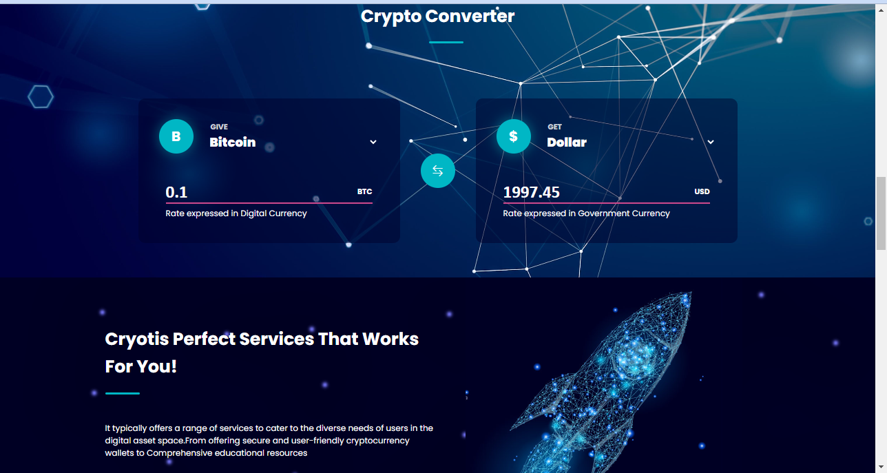

Slide 13
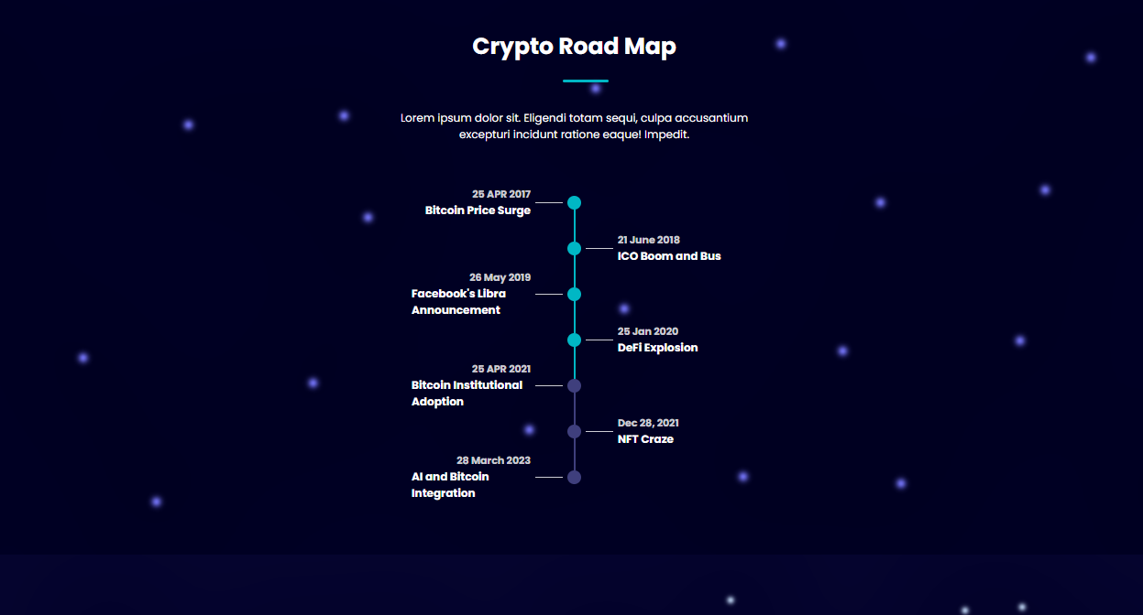

Slide 14
Conclusion
In conclusion, the cryptocurrency trading website represents a pivotal player in the dynamic landscape of digital asset markets. With its user-friendly interface, robust security measures, and an array of features, the platform strives to provide traders with a seamless and efficient experience. The integration of cutting-edge technologies, such as blockchain, ensures transparency, immutability, and trust in transactions.
The website's commitment to compliance with regulatory standards, coupled with continuous innovation, positions it as a reliable and forward-thinking solution for both novice and experienced traders. As cryptocurrencies continue to gain mainstream acceptance, the trading website serves as a gateway to the decentralized financial ecosystem, offering a diverse range of assets and investment opportunities.

Slide 15
References
Delfabbro, P., King, D., Williams, J., & Georgiou, N. (2021). Cryptocurrency trading, gambling and problem gambling. Addictive Behaviors, 122, Article 107021. https://doi.org/10.1016/j.addbeh.2021.107021
Delfabbro P, King DL, Williams J (2021) The psychology of crypto currency trading: Risk and protective factors. J Behav Addict.
3commas: 3Commas Smart Trading terminal and auto trading bots. https://3commas.io/. [Online, Accessed 26 Jan 2020] (2020)
What crypto exchanges do to comply with KYC, AML and CFT regulations. https://cointelegraph.com/news/what-crypto-exchanges-do-to-comply-with-kyc-aml-and-cft-regulations. [Online, Accessed January 11, 2020] (2019).

Slide 16
Thank You

